Slide 1

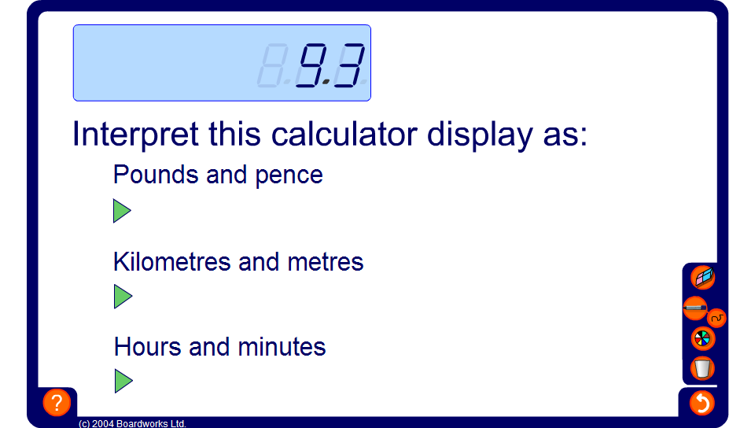


Interpreting the calculator display
Notes:
Use this activity to discuss how to interpret the calculator display in different contexts. Stress that when working with money convention dictates that we cannot write £4.3, for example, but must write £4.30.
Ensure that pupils know metric conversions such as, 1km = 1000m and 1m = 100 cm.
Make sure, too, that pupils understand how to convert decimal fractions of an hour into minutes and decimal fractions of a minute into seconds. Explain that we need to multiply the decimal part of the number by 60 because there are 60 minutes in an hour (and 60 seconds in a minute).
Establish that units that are based on 10s, 100s and 1000s, such as pounds and pence and metric units are easy to work with on a calculator.
Units of time and imperial units are much more difficult. For example, 1.25 hours is 1 hour and 15 minutes (1 quarter of 60 minutes), 1.25 feet is 1 foot and 3 inches (1 quarter of 12 inches) and 1.25 pounds in weight is 1 pound and 4 ounces (1 quarter of 16 ounces).

